Slide 1
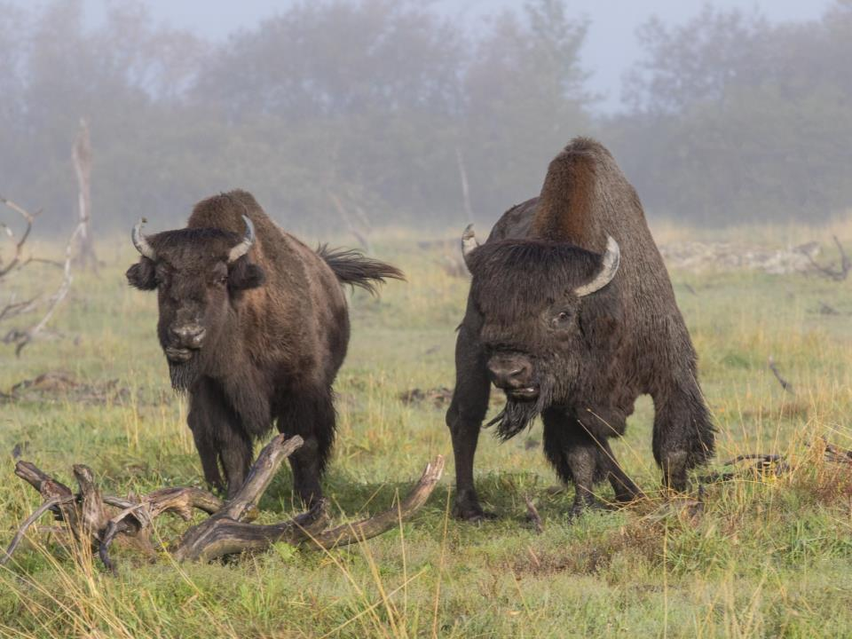
Wood bison gender/age ID
Notes:
lindstrad

Slide 2
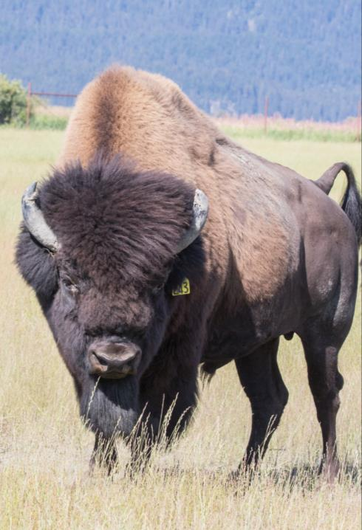
Male bison characteristics
^{Head shape:}
^{Mature bulls generally have:}
^{larger heads, and}
^{broader foreheads than cows.}
^{Head tends to be “V” shaped.}
Mature bulls have long/bushy hair on their forehead making it look like they have bangs.
Mature bulls also have a longer beard.
^{Horn bases:}
^{Larger bases than cows.}
Because of these larger bases, the horns don’t always curve inward as much as cows.
Horns area also often “broomed” or broken from fighting with other bulls during the rut.
^{Note:} these characteristics are less distinctive in young bulls.

Slide 3
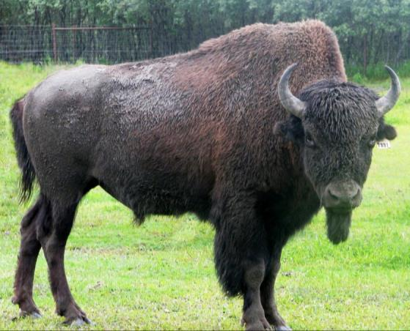
Male bison characteristics
^{Penis sheath:}
^{Males have a penis sheath.}
May not be visible in mid to late winter when the bison’s coat is long!
Urine stream comes out in front of hind legs!
^{Note:} these characteristics are less distinctive in young bulls.

Slide 4
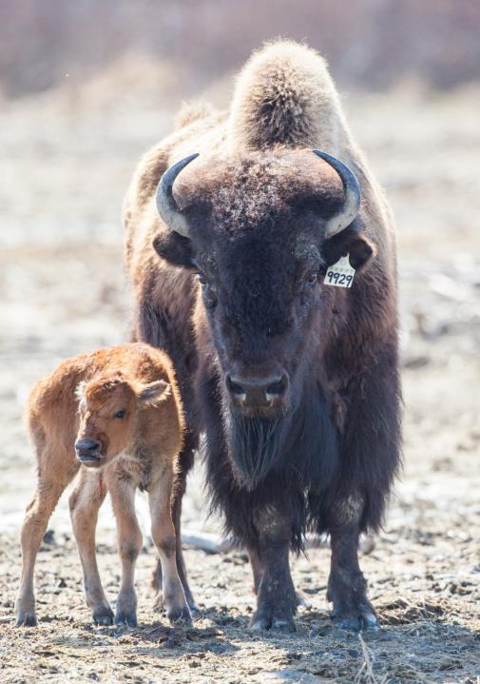
Female bison characteristics
^{Head shape:}
^{Cows generally have:}
^{smaller heads, and}
^{narrower foreheads than bulls.}
^{Head tends to be “0” shaped.}
Older cows can have a wider head.
Cows have less hair on their forehead and a shorter beard.
^{Horn bases:}
^{Smaller bases than bulls.}
Horns look narrow forming the distinctly curved “C” shaped horns.
C

Slide 5
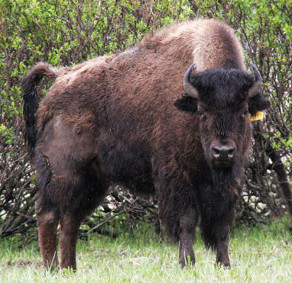
Female bison characteristics
^{Penis sheath:}
^{Females do not have one.}
Can appear to have one with long winter hair!
Urine stream comes out behind hind legs!

Slide 6
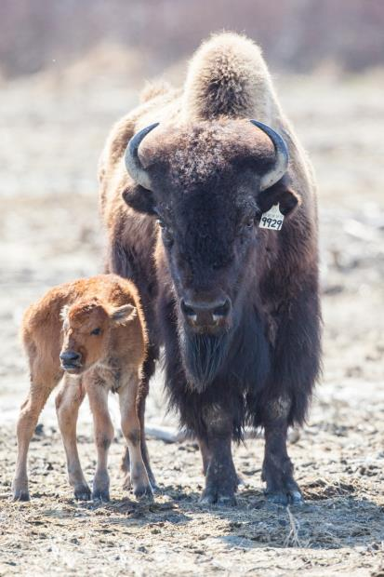
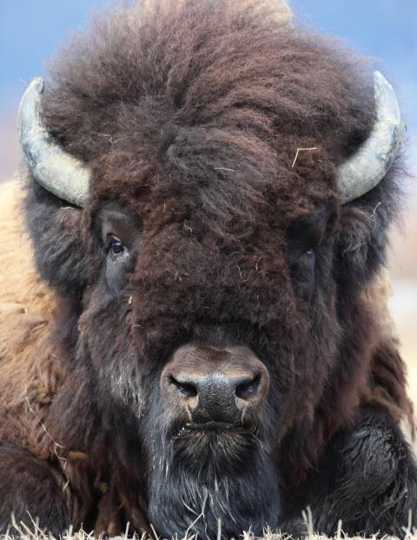
Bison age -based on horn shape and size

Slide 7
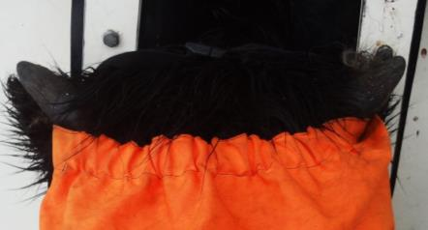
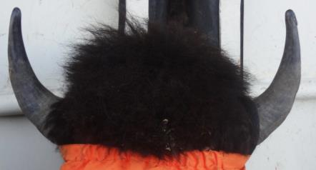
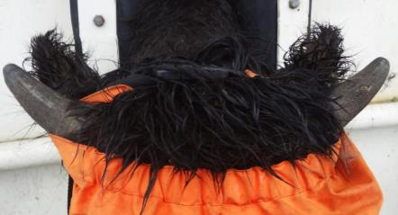
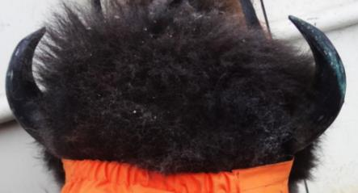
Bison age- based on horns
Calf horns are 1-3 inches long and stick straight out and up from the head.
^{Mid-aged horns are “L” shaped.}
Yearling horns are at 45° and start to turn upward later in the winter.
Older horns develop into a “C” shape. Because cow horns are more narrow, their “C” is more distinct.

Slide 8
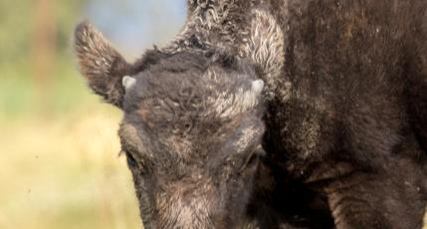
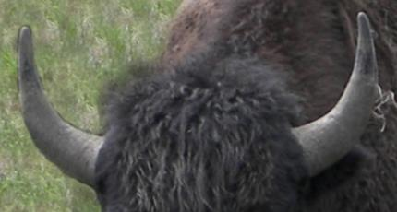
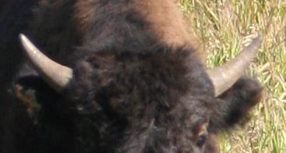
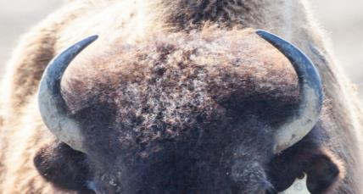
Bison age- based on horns
Calf horns are 1-3 inches long and stick straight out and up from the head.
^{Mid-aged horns are “L” shaped.}
Yearling horns stick straight out at a 45° and start to turn upward later in the winter.
Older horns develop into a “C” shape. Because cow horns are more narrow, their “C” is more distinct.

Slide 9
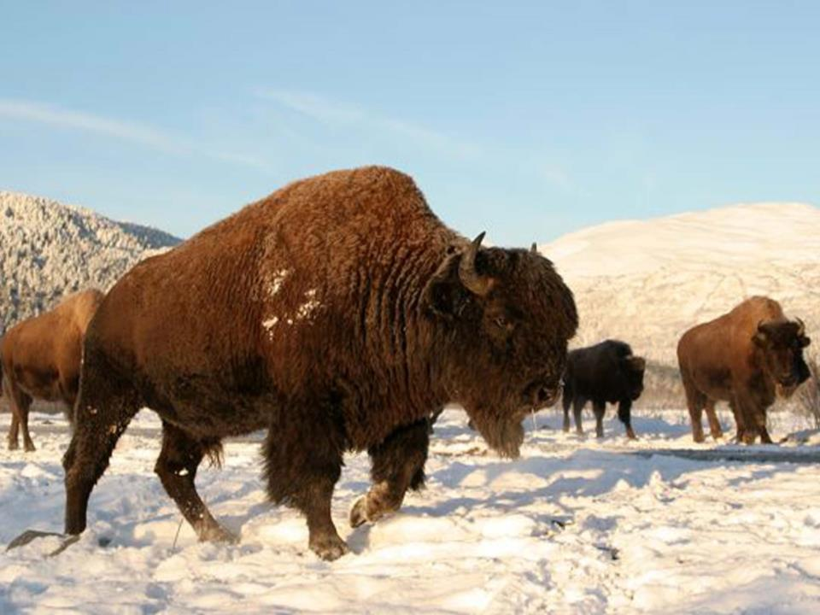
Bison gender and age quiz
?
?

Slide 10
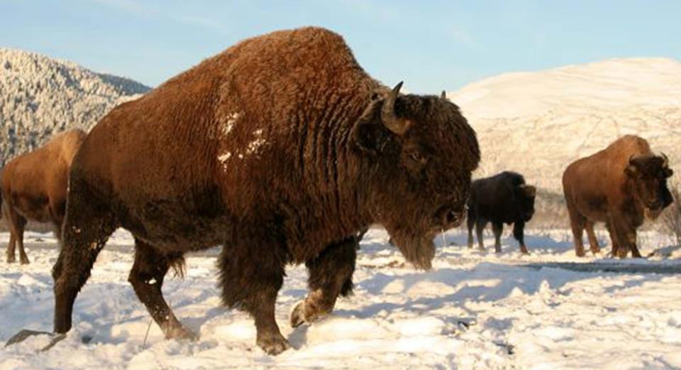
Bull
Cow
Bull, older-aged
Visible penis sheath, large horn bases, wide forehead, horns curved inward into a “C” shape
Cow, older-aged
Narrow head, horns curved inward

Slide 11
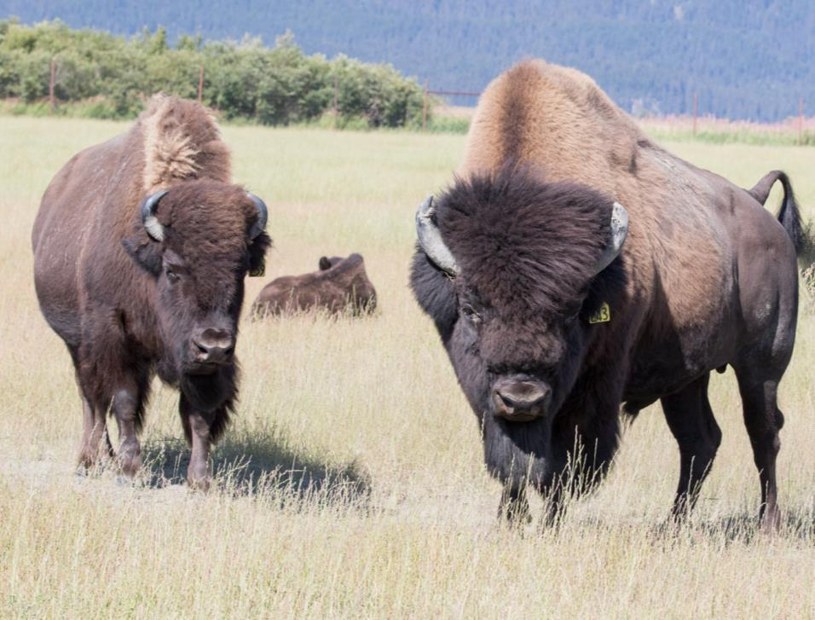
Bison gender and age quiz
?
?

Slide 12
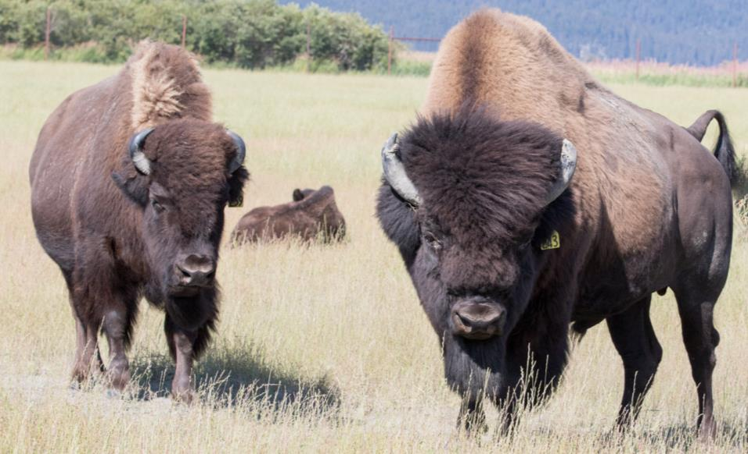
Cow
Bull
Cow, older-aged
Narrow head, horns curved inward
Bull, older-aged
Large horn bases, wide forehead, massive afro and beard, horns curved inward and slightly “broomed”

Slide 13
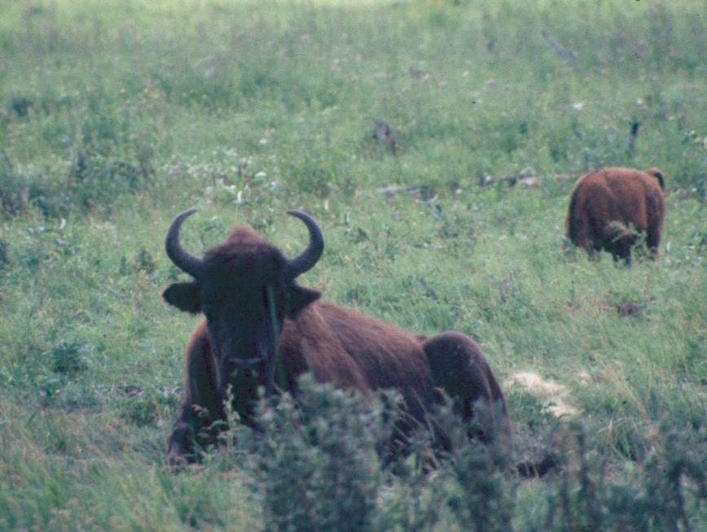
Bison gender and age quiz
?

Slide 14
Cow
Cow, older-aged
Narrow head, horns narrow and distinctly “C” shaped

Slide 15
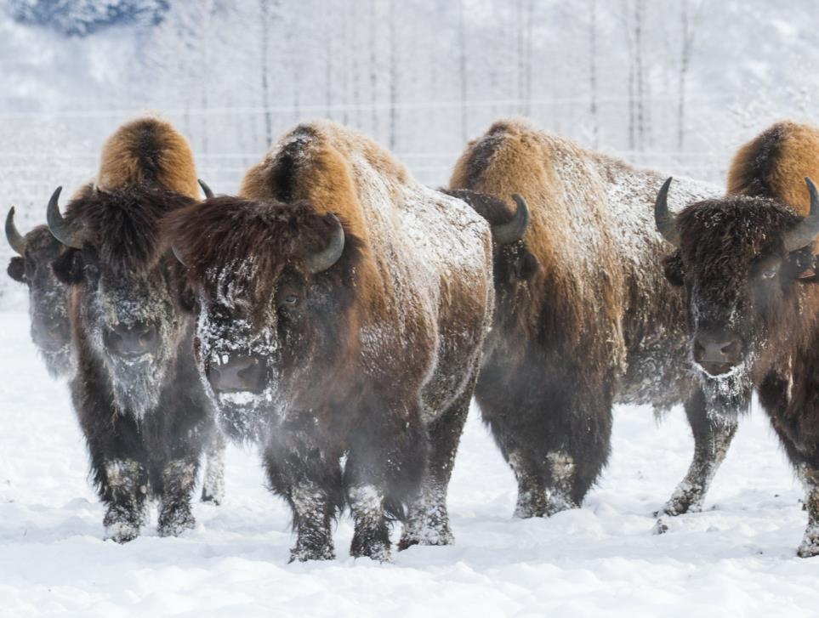
Bison gender and age quiz
?
?
?
?
?

Slide 16
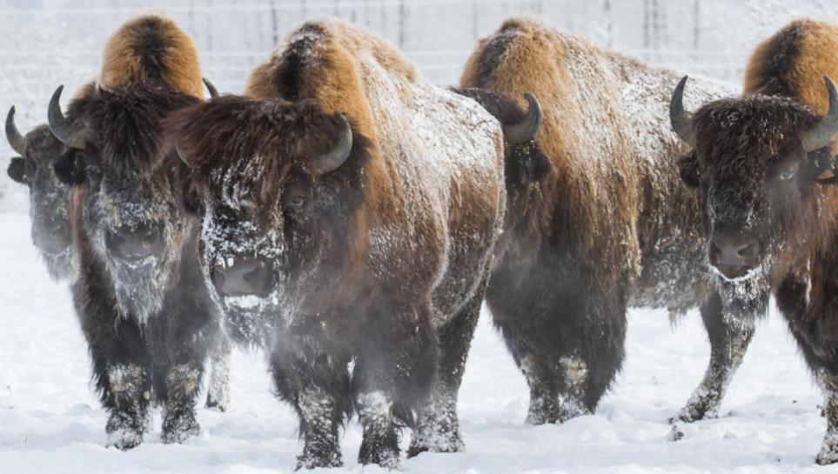
Bull
Bull
Bull
Bull
Bull
Bull, middle-aged
Wide horn base, extensive hair on head, horns starting to curve inward
Bull, older-aged
Wide horn base, wide forehead, extensive hair on head, horns curved inward in distinct “C” shape
Bull, older-aged
Wide horn base, horns curved inward in distinct “C” shape
Bull, middle-aged
Wide horn base, wide forehead, hairy head but not as extensive as older bulls, horns starting to curve inward
Bull, older-aged
Wide horn base, wide forehead, extensive hair on head, horns curved inward in distinct “C” shape

Slide 17
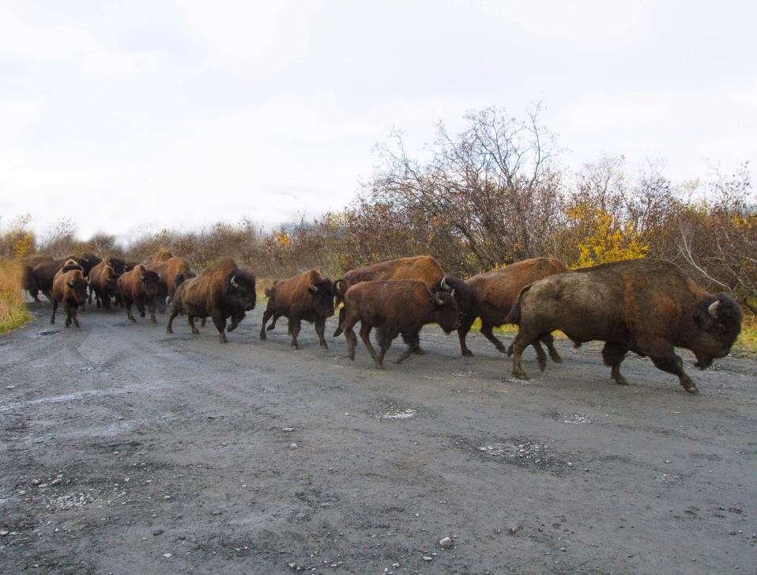
Bison gender and age quiz
?
?
?
?
?
?
?
?
?
?
?

Slide 18
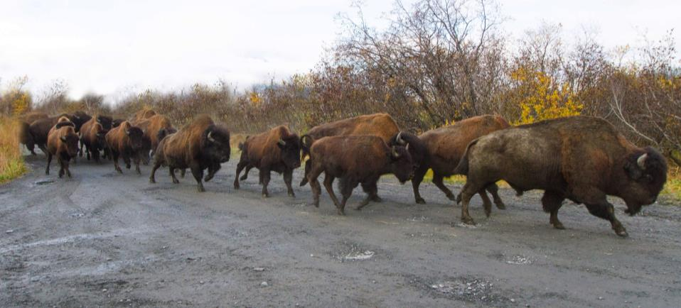
Bull
Bull
Bull
Bull
Yearling bull
Bull
Bull
Bull
Bull
Bull
Bull, older-aged
Large horn bases, wide forehead, horns curved inward in “C” shape
Bull, older-age
Large horn bases, wide forehead, extensive hair on head, horns curved inward in “C” shape
Bull, adult
Large body size, visible penis sheath
Bull, yearling
Horns straight out at 45°, wider forehead
Bull, young-age
Larger horn bases, wider forehead, horns in “L” shape
Bull, young-age
Larger horn bases, wider forehead, horns in “L” shape
Bull, older-age
Large horn bases, wide forehead, extensive hair on head, horns curved inward in “C” shape
Bull, young-age
Larger horn bases, wider forehead, horns in “L” shape
Bull, young-age
Larger horn bases, wider forehead, horns in “L” shape
Bull, older-age
Visible penis sheath, Large horn bases, wide forehead, extensive hair on head, horns curved inward in “C” shape

Slide 19
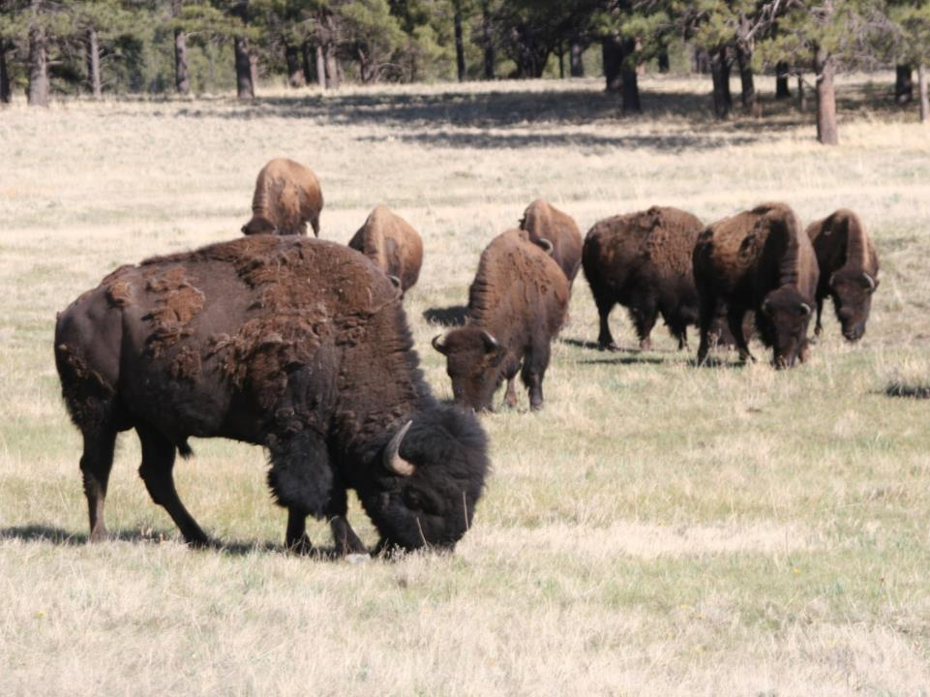
Bison gender and age quiz
?
?
?
?

Slide 20
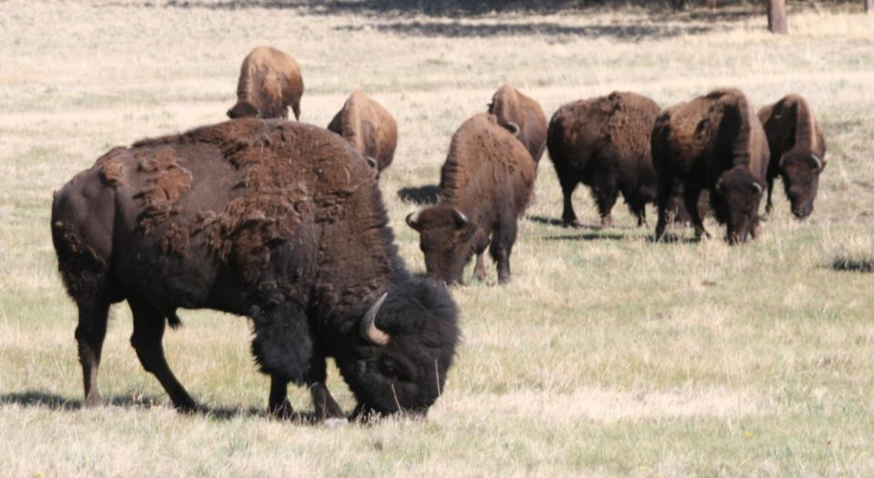
Cow
Cow
Cow
Bull
Cow, middle-aged
Narrow face, narrow horn base, horns starting to curve inward
Bull, middle-aged
Visible penis sheath, wide horn base, extensive hair on head, horns starting to curve inward
Cow, older-aged
Narrow face, narrow horn base, horns curved inward in distinct “C” shape
Cow, older-aged
Narrow face, narrow horn base, horns curved inward in distinct “C” shape

